Slide 1
To Infinity And Beyond…
Connecting with the e-universe
Notes:
What are you hoping for today?

Slide 2
To Infinity And Beyond…
What are we doing?
What’s the actual need?
What do you actually need?
Editing Tools
Recording, streaming and uploading
Copyright
Learnings
Connecting with the e-universe

Slide 3
What’s the Actual need?
Some questions to ask yourself …
What am I trying to achieve?
Who am I recording for?
What do they need?
What am I recording?
Do I even need pictures?
Is it live or delayed?
Where do I want to record from?
What hardware do I need?
What software?
Who do I have that can support this?
What’s the simplest solution?

Slide 4
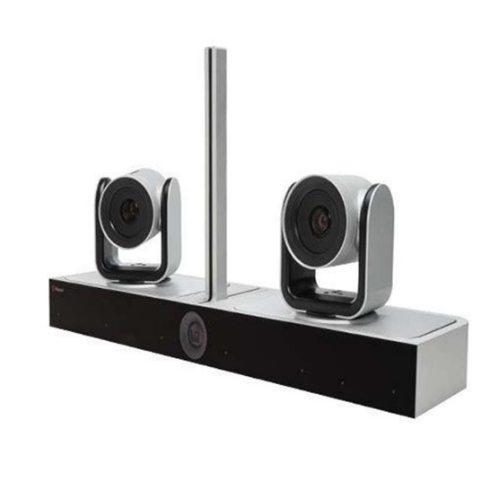
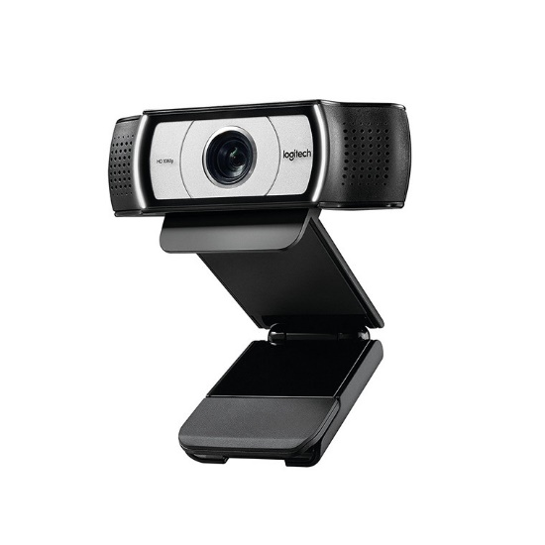
What do you Actually need?
Poly EagleEye Director II with 2 EagleEye IV 12x Cameras
Logitech C930e Business Grade Full HD 1080P Conference Webcam, 2 omni-directional Mics, Microsoft Teams Certified, Compatible With Other UC Applications, Privacy shutter, Autofocus,
Your cellphone …
$25000
$260
$ …?

Slide 5
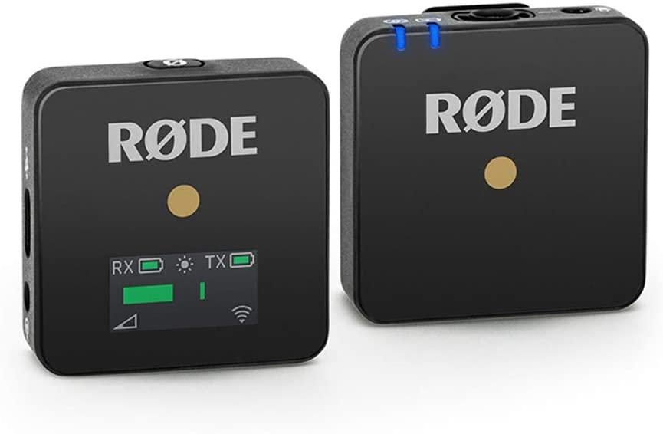
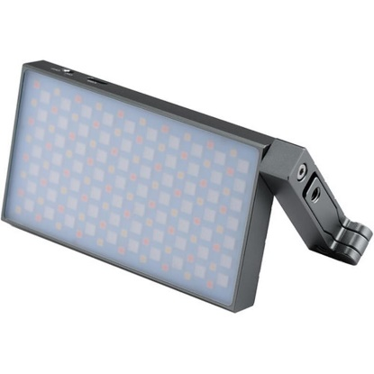
What do you actually need?
Nikon Z50
Rode Wireless GO wireless microphones
GODOX LED Light
$1647
$330
$200
And a decent computer, and a tripod, and cables, and knowledge …

Slide 6
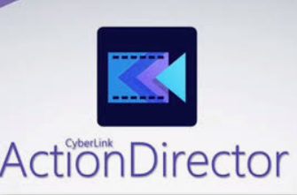
Editing Tools…
iMovie
Android

Slide 7
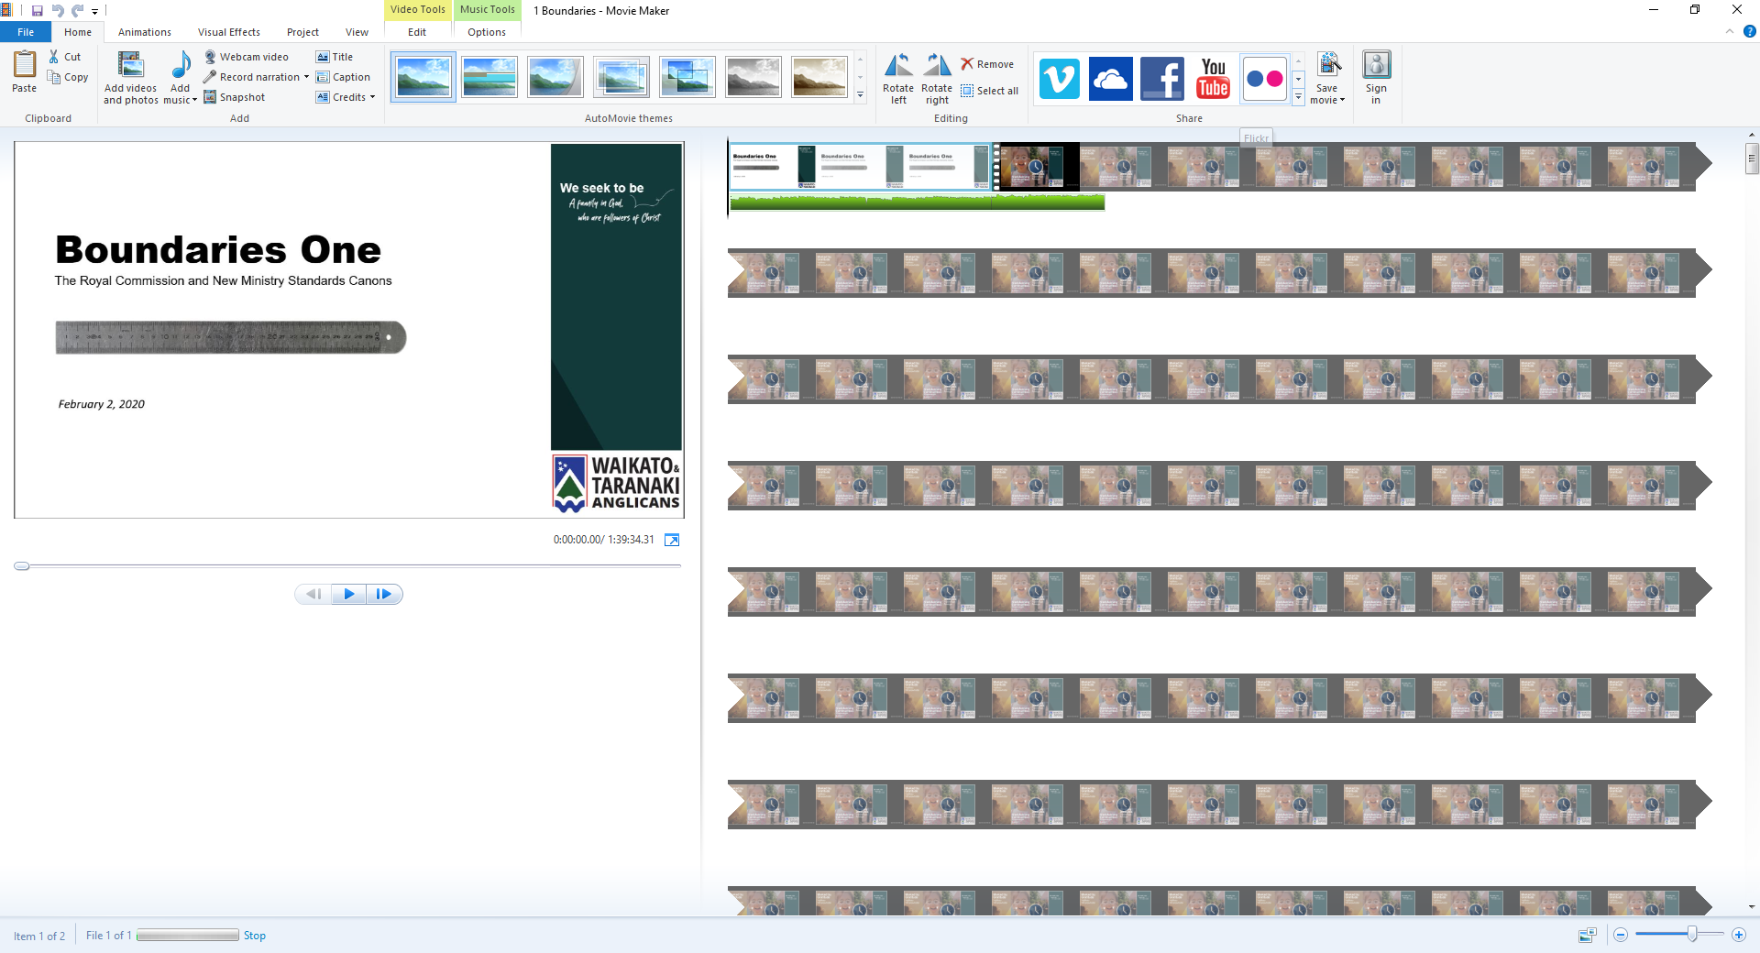
Editing Tools…
Windows Movie Maker

Slide 8
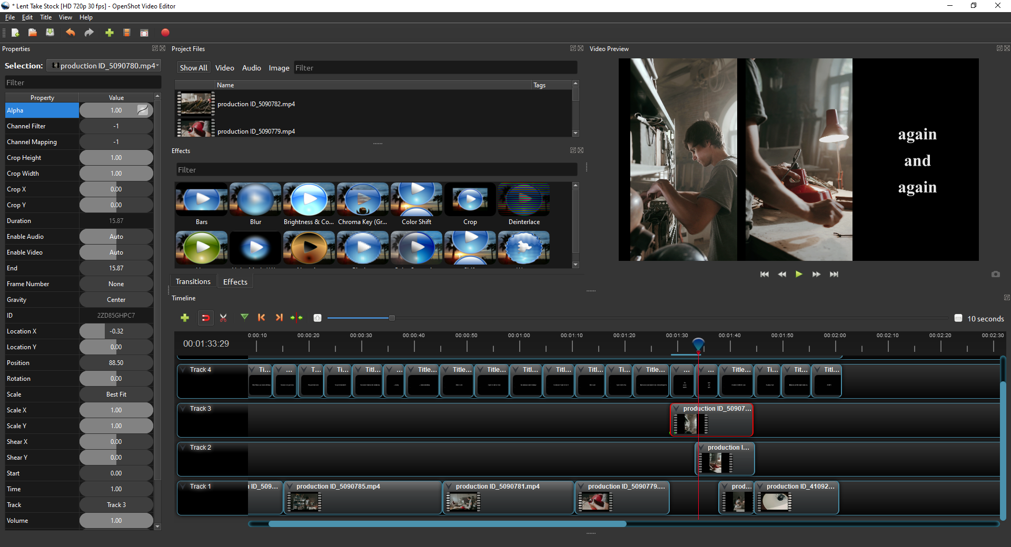
Editing Tools…
OpenShot Video Editor

Slide 9
Where is your recording heading?
Live broadcast
Zoom
Zoom to Facebook Livestream
Zoom to YouTube ‘Live’stream (20sec delay)
Facebook Live
YouTube
Record and Upload
YouTube
Vimeo
Zoom

Slide 10
Copyright
ANZPB
Implied copyright
Acknowledgement required
No editing*
You must own the hardcopy already
CCLI https://nz.ccli.com/
You may not broadcast concerts where you have charged for tickets or invited donations
APRA AMCOS NZ https://apraamcos.co.nz/about-us/
They have a licence which enables you to charge if you use an Online Mini Licence (just make sure the licence covers the proposed content)
Notes:
* Special note: please, a special request from me, please do not use Eucharistic liturgy which is not approved for use in this Province, esp if you have a litigious congregation. Statute 737 ‘Authorised means approved by the General Synod/Te Hīnota Whānui.’ The right to use liturgy from around the Communion has been democratically and synodically revoked. Rubbish and non-authorised liturgy will put you in breach of Title D, Canon I, ss 8, 9 and 12. Your response to such a complaint may then put you in breach of s 24 which requires you to be temperate, self-controlled and not abusive. Title G Canon 14 will tell you what is approved.

Slide 11
Copyright
YouTube
Will reject any video upload with content that it deems commercial
It has software that scans livestreams as well
Commercial Music
Beware, there can be more than one ‘owner’ of the music – the original artist/creator and the owner of the specific recording

Slide 12
‘Learnings’
A hard connection is always better than wifi
Test everything, twice …
In the same environment (time of day, people, background noise)
The simpler the better
Beware the cheap, if it seems too good to be true, it’s probably no longer compatible …

